Slide 1
Spark Machine Learning
Clara, Tyler, Julio, Preston

Slide 2
Machine Learning
AI - GOOGLE DEFINITION
Artificial intelligence is a field of science concerned with building computers and machines that can reason, learn, and act in such a way that would normally require human intelligence or that involves data whose scale exceeds what humans can analyze.
AI is a broad field that encompasses many different disciplines, including computer science, data analytics and statistics, hardware and software engineering, linguistics, neuroscience, and even philosophy and psychology.
On an operational level for business use, AI is a set of technologies that are based primarily on machine learning and deep learning, used for data analytics, predictions and forecasting, object categorization, natural language processing, recommendations, intelligent data retrieval, and more.
ML- GOOGLE DEFINITION
Machine learning is a subset of artificial intelligence that enables a system to autonomously learn and improve using neural networks and deep learning, without being explicitly programmed, by feeding it large amounts of data.

Slide 3
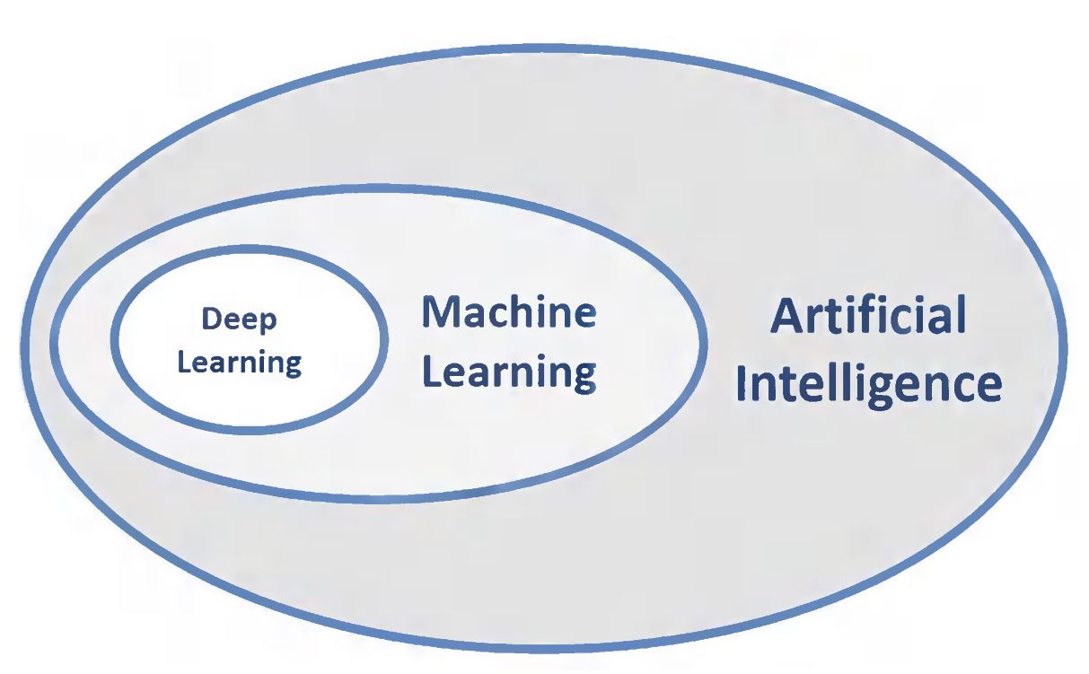
Types of learning
Supervised Learning
X -> Y
Labeled Data
Unsupervised Learning
X -> X
Unlabeled Data
Reinforcement Learning
Based on Rewards and Rules
Make our data

Slide 4
Neural Nets VS Trees VS Forest
Neural Net
Powerful models that can understand complex patterns
Useful for high feature count or non-linear relationships
Can handle missing/outlier values
Require Large amount of data
Hard to interpret
Trees
Easy to interpret
Useful when data has categorical features or interactions between features
Suffers from overfitting and small changes in data
Forest
Bunch of trees together
Improves Accuracy and Robustness of model
Handle large number of features
Provide info about relative importance of features
Less interpretable than Trees

Slide 5
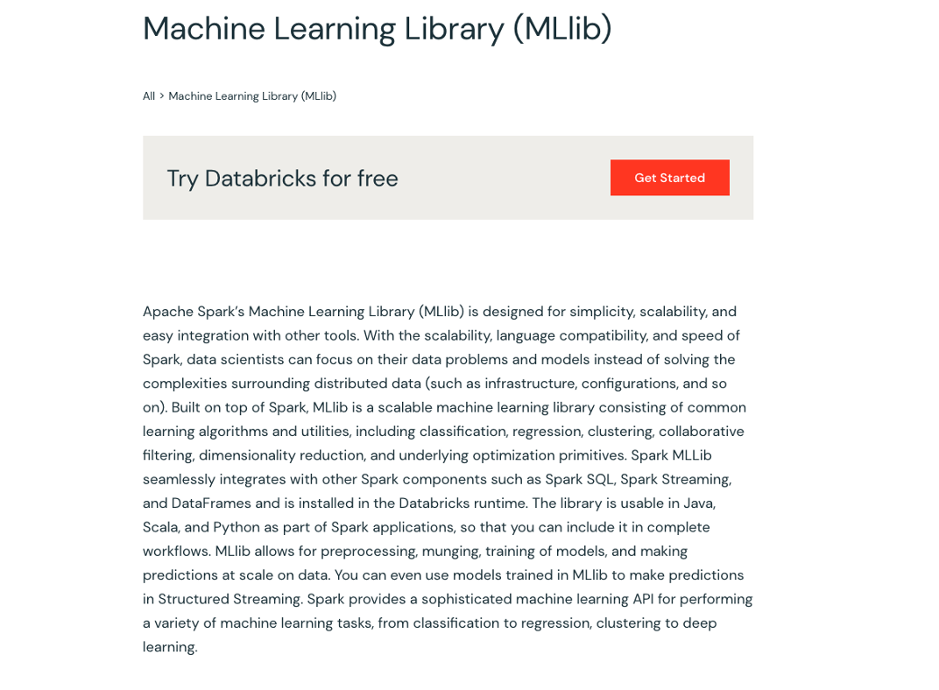
What is MlLib?
Machine learning Library
In simple words: DataFrame-based API built on top of RDDs.
High level takeaways
•Simplicity
•Scalability
•Easy integration and language capability (Python, SQL, Scala, R and Java)
•Speed of Spark and components(Spark SQL, Spark Steaming and Data Frames)

Slide 6
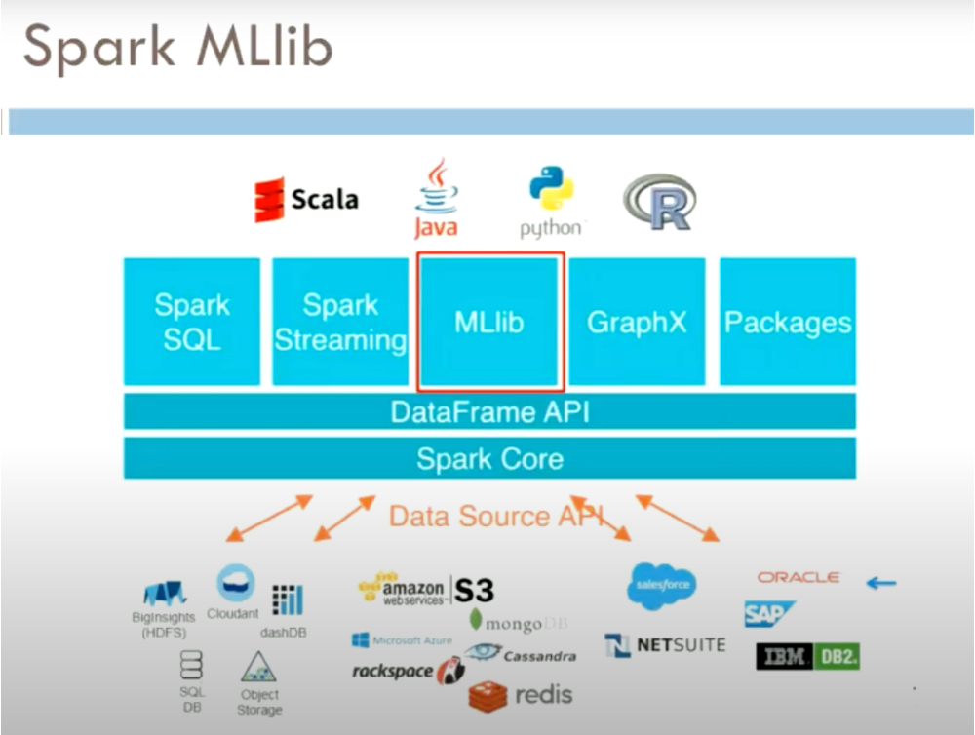

Slide 7
ML Algorithms
•Classification
•Regression
•Clustering and
•Collaborative filtering
Featurization
•Feature extraction
•Transformation
•Dimensionality reduction
•Selection
Persistence
•Saving and load algorithms
•Models
•Pipepiles
Pipelines
•Tools for constructing
•Evaluating
•Tuning
•Model Persistence
Utilities
•Linear algebra
•Statistics
•Data handling
Spark MLlib
Components

Slide 8
ML Pipelines
ML Pipelines is a way of structuring and organizing the workflow of a ML project. For example:
Data Preprocessing -> Feature Engineering -> Model Training and Selecting -> Hyperparam Tuning -> Model Evaluation -> Deployment

Slide 9
ML Pipelines
Why is pipelining important?
Volume: only call parts of the workflow when you need them
Variety: when you expand your model portfolio, you can use pieces of the beginning stages of the workflow by simply pipelining them into the new models without replicating them.
Versioning: when services are stored in a central location and pipelined together into various models, there is only one copy of each piece to update

Slide 10
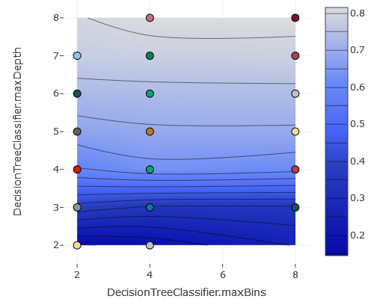
ML Flow
Your Autologger in MLLib
Parmeter grids
Model saving
Graphs!

Slide 11
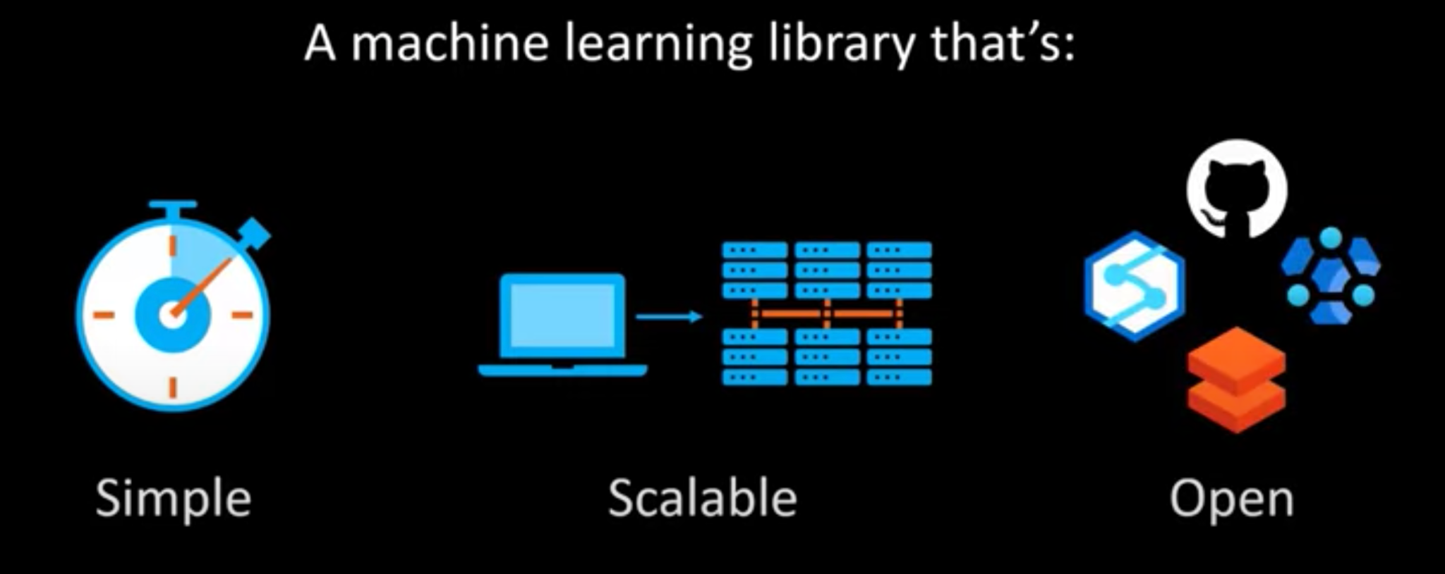
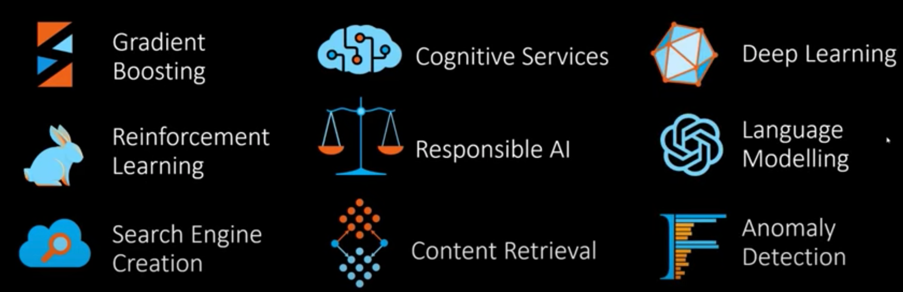
Synapse ML
Notes:
Components are composable - little code required
Designed to execute on you computer or on a database

Slide 12
Regression
Show regression model that uses Synapse ML

Slide 13
Judging the Goodness of a Model
 | Predict: Yes | Predict: No
Was: Yes | 60 | 25
Was: No | 2 | 13
Classification Metrics
Confusion matrix, True Positives (TP), True Negatives (TN), False Positives (FP), False Negatives (FN)
Accuracy: (TP + TN) / Total Drawbacks: Don’t know whether the model is skewed towards Yes or No.
Precision: TP / (TP + FP) When the model predicts Yes, how likely is it to be correct?
Recall: TP / (TP + FN) When a Yes is examined, how likely is the model to correctly identify it?
F1 (both): 2*Pr*Re/(Pr + Re) Useful to show the trade-off between precision and recall.

Slide 14
Judging the Goodness of a Model
Regression Metrics
Mean Squared Error (MSE): 1/N * 𝚺 (Yactual - Ypred) ^ 2
Most common. Take the square root to get the RMSE, which is in the same units as predictions.
Mean Absolute Error (MAE): 1/N * 𝚺 |Yactual - Ypred|
More resistant to outliers. Or more exclusive of them. Depends on what you want.
Final Note: These are used by people to evaluate the model, and not necessarily by the computer to train the model. This is because these metrics might not be differentiable.

Slide 15
Questions?

